Slide 1

NLP Literature Review
Mostafa – Mohamad Helmy – Sameh – Mohamad Fouad
Assignment 3
Group 7
Prof. Arya Rahgozar
Dr. Migao Wu

Slide 2
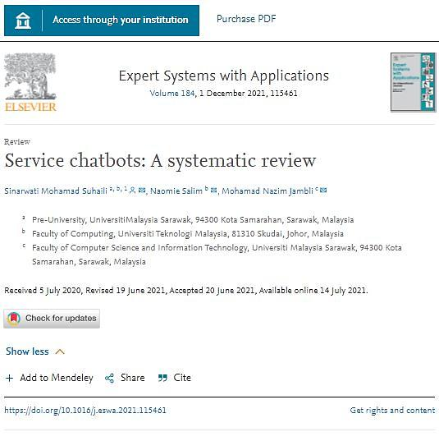
Chatbot Literature Review Objectives
Gool
presents the development of an ecommerce sales chatbot in order to provide customer support and increase sales. The system uses machine learning for natural language understanding.

Slide 3
Introduction
presents the development of an ecommerce sales chatbot in order to provide customer support and increase sales. The system uses machine learning for natural language understanding.
Some company try to serve his customer online by provide live chat support
The solution try to use natural language processing (NLP) and natural language understanding (NLU) and take them a step closer to understanding context
Other attempts have been to develop and train artificial intelligence to answer basic faq questions.

Slide 4
downside e-commerce
downside about using e-commerce as a means to sell your products could be that some customers are wary of not having direct face to face contact with a sales representative.

Slide 5
The biggest challenge and solution
is to develop a chatbot that can render an experience for real human sales agents, bringing together two industries, e-commerce sales and AI to create an immersive model to perform synergy.
the major challenges of building an automated customer support system is categorizing natural language.
tried to explore the Support Vector Machines (SVMs) to categorize texts
SVM performs better for text categorization because of high dimensional input space, fewer irrelevant features, sparse document vectors and the ability to linearly separate text categorization problems.

Slide 6
Improvements
George Kassabgi [4] has shown a very simple algorithmic approach to classify texts using multinomial naive bayes.
He also explained a simple machine learning approach using a neural network to classify texts.
Tensorflow is a great tool machine learning developed by Google.
Illia Polosukhin [6] explained a text classification model by using Tensorflow
Sadia Zaman Mishu and S. M.Rafiuddin [7] have compared the performance among Naïve Bayes, Multinomial Naive Bayes, Bernoulli Naive Bayes, Logistic Regression, Stochastic Gradient Descent, SVC, Linear SVC and Back Propagation Network.

Slide 7
SYSTEM structure
NLU :
Engine The Natural Language Understanding engine is one of the major parts of the system.
Recommendation Engine:
The purpose of the recommendation engine is to find the products that users are more interested to purchase
Adaptive Pricing Engine:
The adaptive pricing engine generates real time discounts or deals for users.
Bot Engine :
The Bot Engine is the core platform of this system. It is connected with the NLU Engine and Adaptive Pricing Engine.

Slide 8
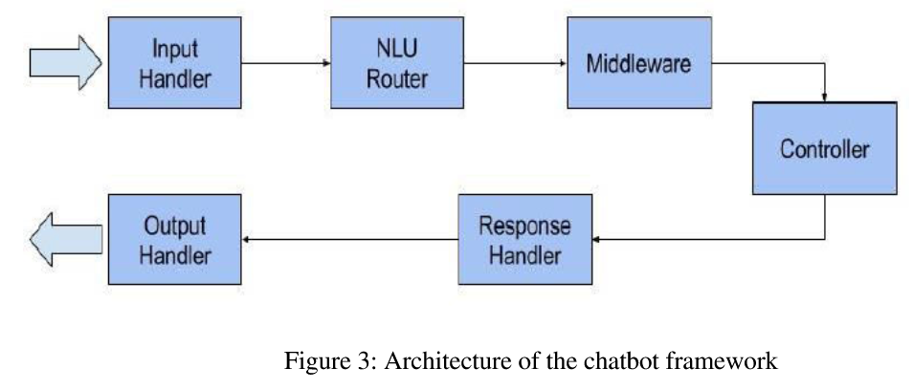
Bot Engine
The main focus of the project is to develop a modular chatbot architecture so that accuracy can be improved, new features can be added easily. In order to do that we choose microservice architecture Instead of creating a larger system, several smaller components were developed which are connected with each other.

Slide 9
Results
building such modular system is to make the system available to more platforms
This present NLU engine trains its classifier from the classified training data provided by the admins.
e-commerce has had a major impact on society and the way business is done on a global scale.
This project may help improve the relationship with customers which can lead to more sales.
lead to customer service cheaper and more satisfying.

Slide 10
Application

Slide 11
https://www.researchgate.net/publication/348668779_Development_of_An_e-commerce_Sales_Chatbot
Kassabgi, G. (2017, January 11). Text Classification using Algorithms. Chatbotslife. Retrieved from https://chatbotslife.com/textclassification-using-algorithms-e4d50dcba45/
[5] Kassabgi, G. (2017, January 24). Text Classification using Neural Networks. Machine learnings. Retrieved from https://machinelearnings.co/text-classification-using-neural networksf5cd7b8765c6/
[6] Polosukhin, I. (2016, November 19). TensorFlow — Text Classification. Medium. Retrieved from https://medium.com/@ilblackdragon/tensorflow-text-classification- 615198df9231/
[7] Mishu, S. Z., & Rafiuddin, S. M. (2016, December). Performance analysis of supervised machine learning algorithms for text classification. In Computer and Information Technology (ICCIT), 2016 19th International Conference on (pp. 409-413). IEEE.

